Slide 1
BIPOLAR JUNCTION TRANSISTOR (BJT)
DC BIASING
ENGR. JOVETTE A. PECAYO
INSTRUCTOR

Slide 2

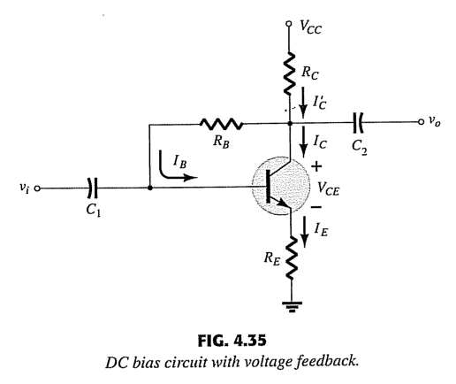
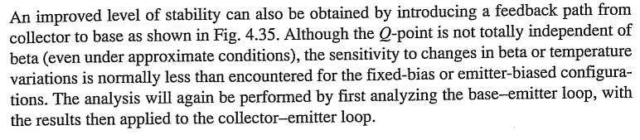
BJT DC BIASING

Slide 3
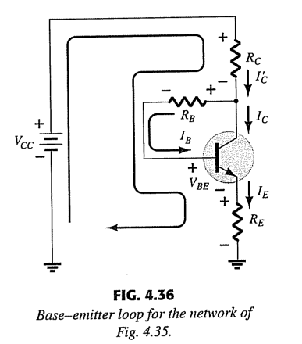
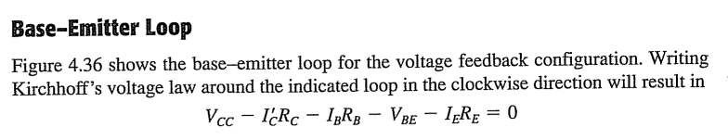
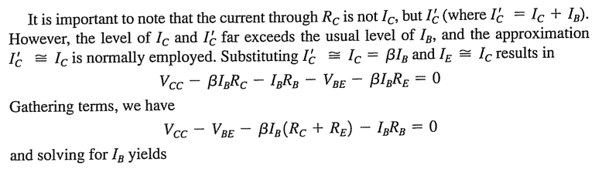

BJT DC BIASING

Slide 4
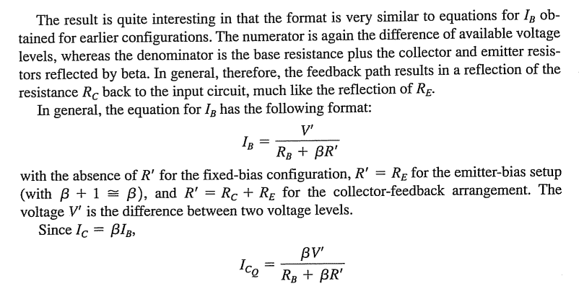
BJT DC BIASING

Slide 5
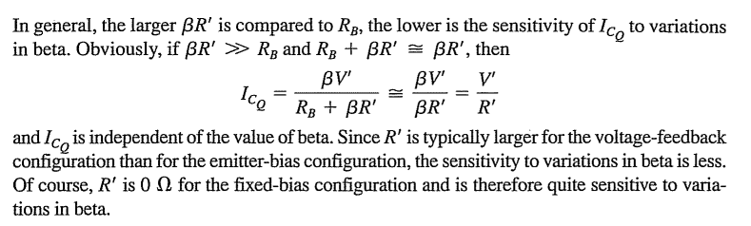
BJT DC BIASING

Slide 6
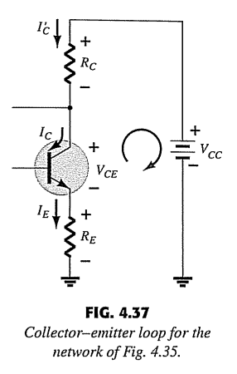
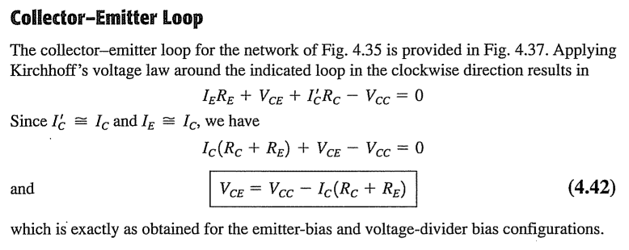
BJT DC BIASING

Slide 7
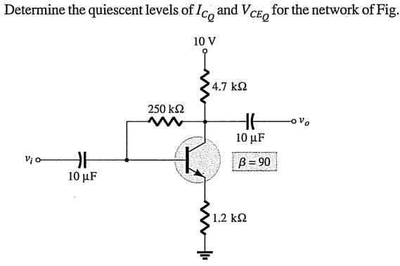
EXAMPLE NUMBER 1:

Slide 8
SOLUTION:

Slide 9
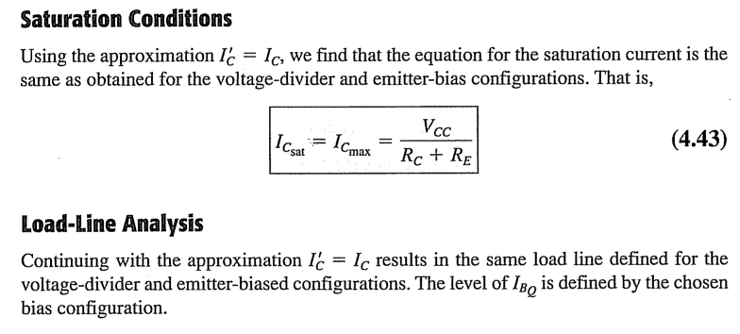
BJT DC BIASING

Slide 10
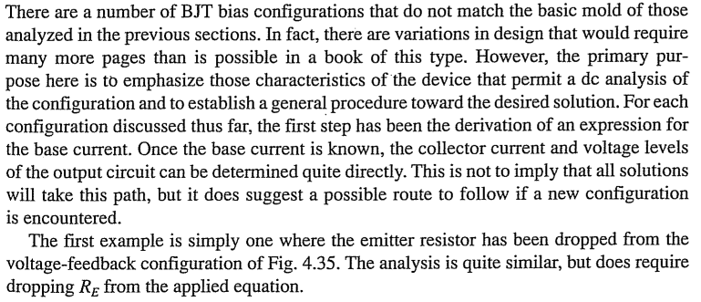
BJT DC BIASING

Slide 11

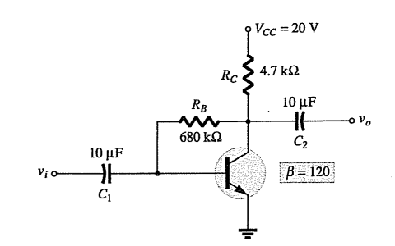
EXAMPLE NUMBER 2:
For the figure below, find the following:

Slide 12
SOLUTION:

Slide 13
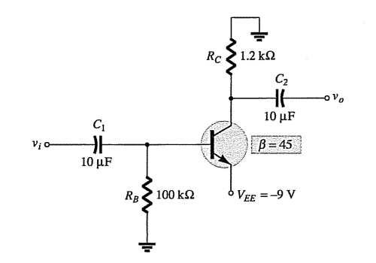
EXAMPLE NUMBER 3:
For the figure below, find Vc and VB .

Slide 14
SOLUTION:

Slide 15
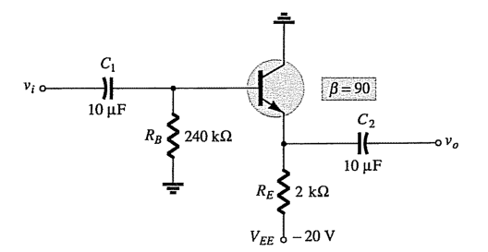
EXAMPLE NUMBER 4:
Determine VCEQ and IE for the network:

Slide 16
SOLUTION:

Slide 17

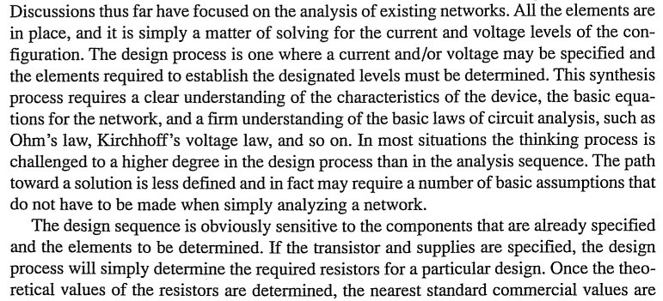
BJT DC BIASING

Slide 18
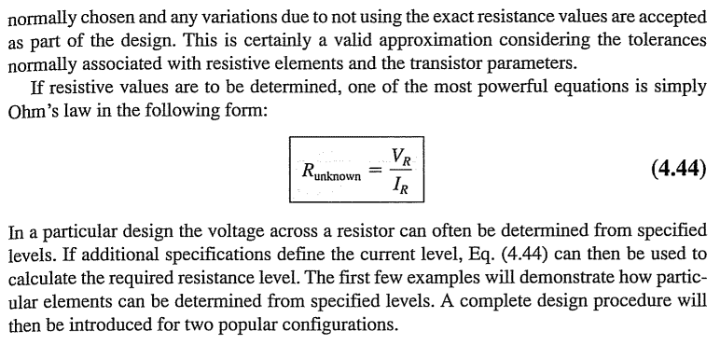
BJT DC BIASING

Slide 19
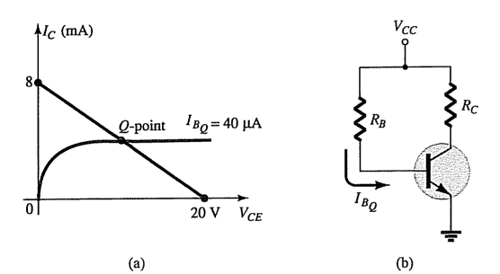
EXAMPLE NUMBER 5:
Given the characteristics, determine VCC, RB and RC for the fixed bias configuration.

Slide 20
SOLUTION:

Slide 21
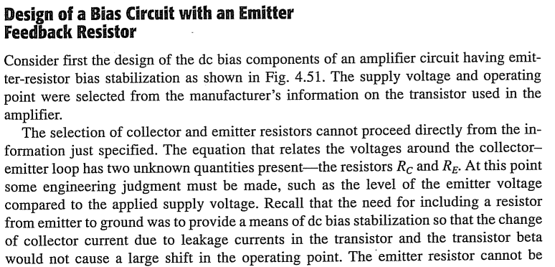
BJT DC BIASING

Slide 22
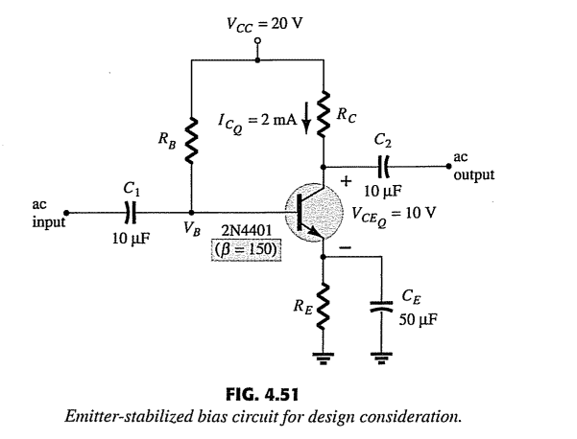
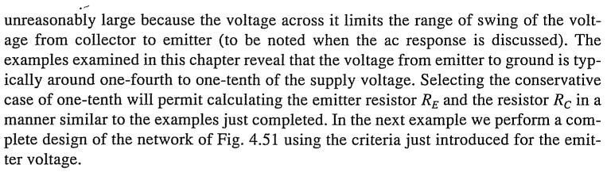
BJT DC BIASING

Slide 23
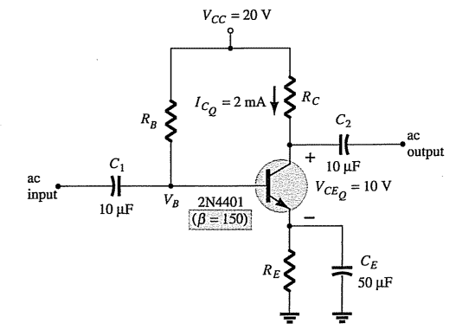
EXAMPLE NUMBER 6:
Determine the resistor values for the network in the figure below for the indicated operating point and voltage supply.

Slide 24
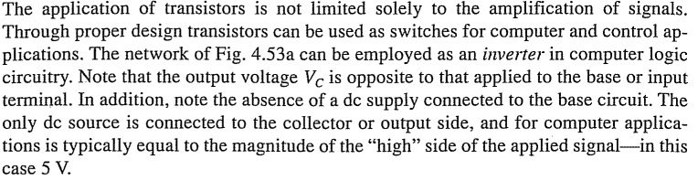
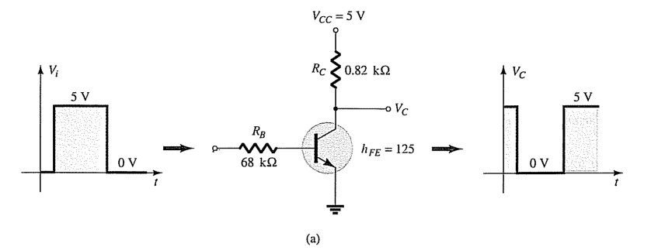
BJT DC BIASING

Slide 25
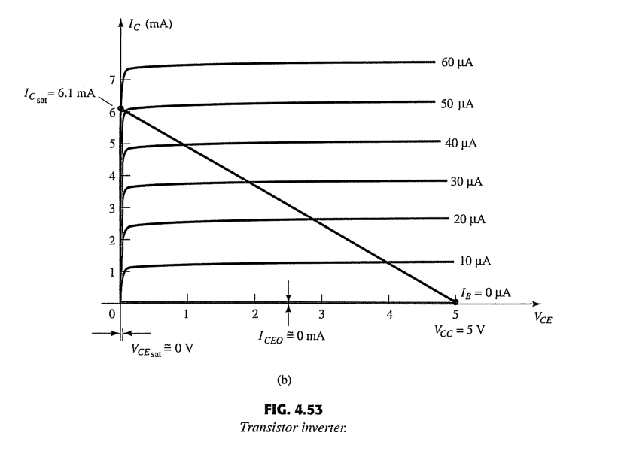
BJT DC BIASING

Slide 26
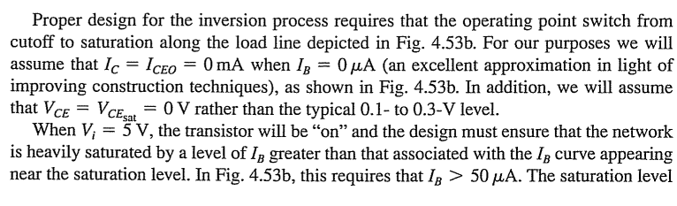
BJT DC BIASING

Slide 27
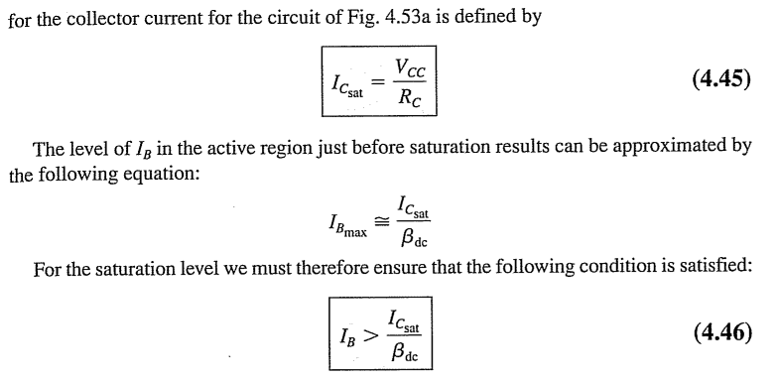
BJT DC BIASING

Slide 28
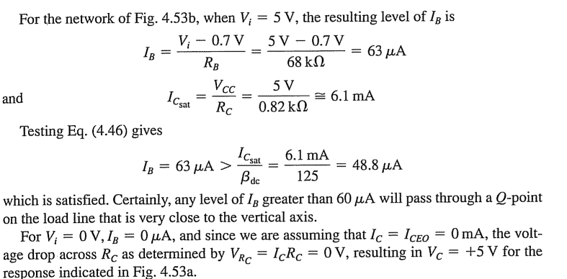
BJT DC BIASING

Slide 29
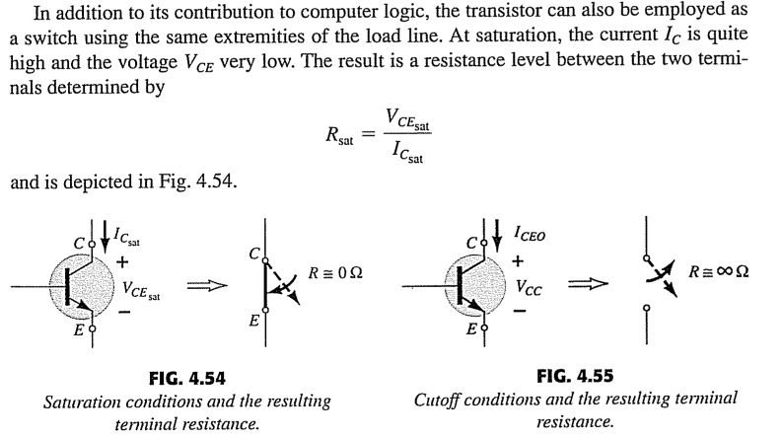
BJT DC BIASING

Slide 30
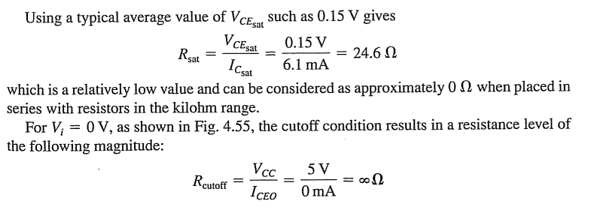
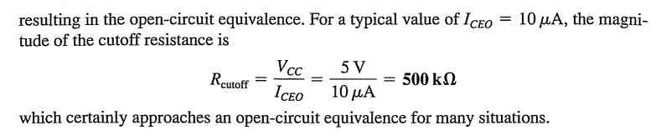
BJT DC BIASING

Slide 31
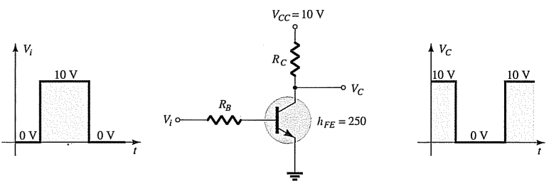
EXAMPLE NUMBER 7:
Determine RB and RC for the transistor inverter in the figure below. Icsat=10mA

Slide 32
SOLUTION:

Slide 33
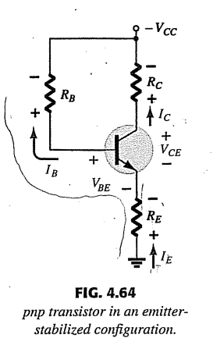

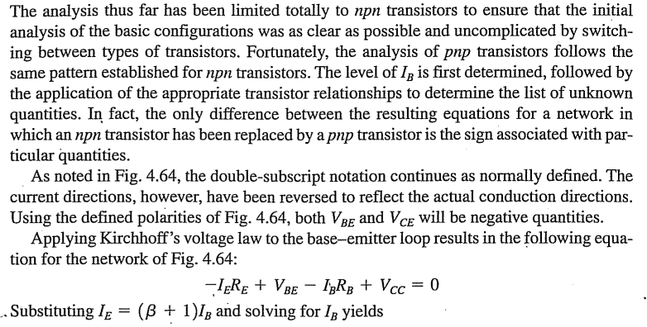

BJT DC BIASING

Slide 34
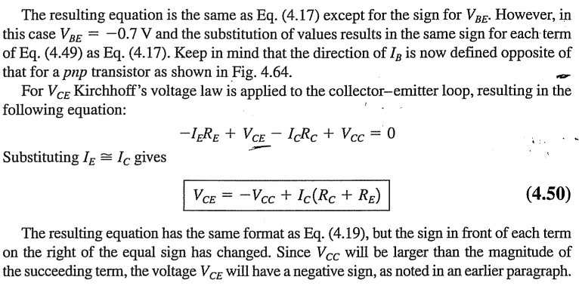
BJT DC BIASING

Slide 35
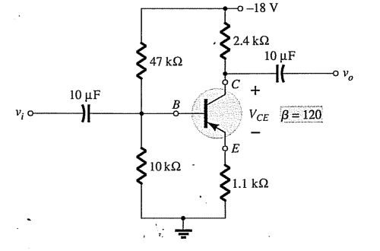
EXAMPLE NUMBER 8:
Determine VCE for the voltage divider bias configuration.

Slide 36
SOLUTION:

